Slide 1
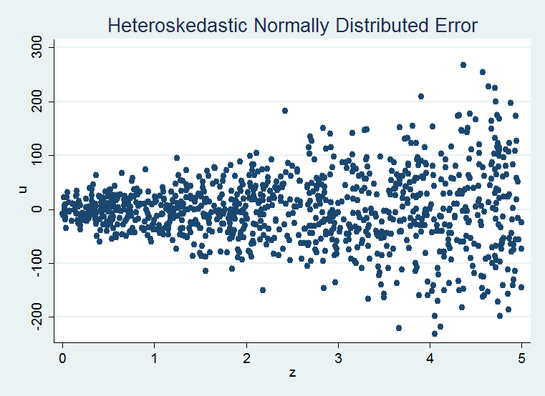

Heteroskedasticity & Robust Standard Errors
Recap I: Those SLR’s, MLR’s, LUEs and BLUE
… II: MSE’s, RMSE’s, and Standard Errors
… III: Homoskedasticity v. Heteroskedasticity
Heteroskedasticity: Learning from the Sample Mean Estimator
Bogus Standard Errors & Weighted Least Squares
Robust standard errors to the rescue!
… , robust in action! An example

Slide 2
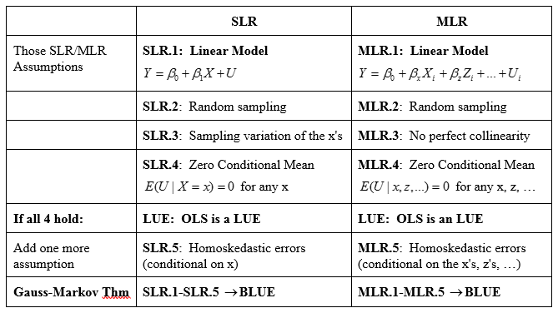
Recap I: Those SLR’s, MLR’s, LUEs and BLUE

Slide 3
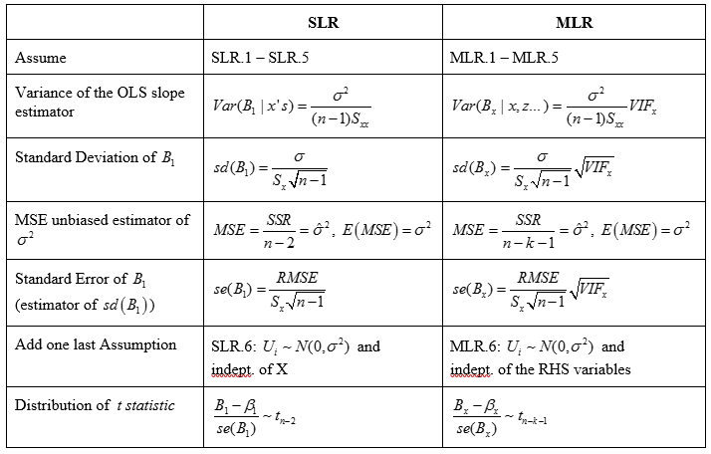
Recap II: MSE’s, RMSE’s, and Standard Errors

Slide 4
Recap III: Homoskedasticity v. Heteroskedasticity

Slide 5
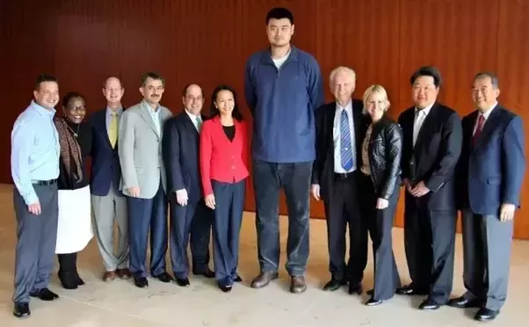
Heteroskedasticity: Learning from the Sample Mean Estimator

Slide 6
OLS and Heteroskedasticity:
Bogus Standard Errors & Weighted Least Squares

Slide 7
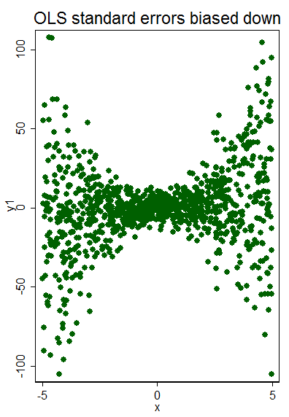
What’s a researcher to do?
Robust standard errors to the rescue!

Slide 8
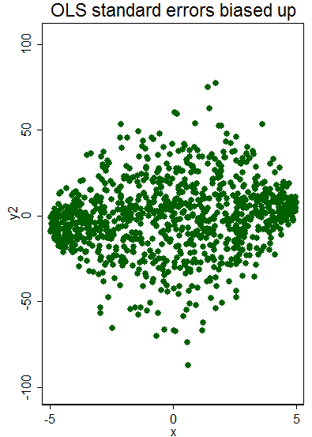
, robust in action!: An example

